Slide 1
Sequence Labeling Problem
Hung-yi Lee
Notes:
I do not know what is MEMM
Why not just use RNN?
add constraint?
How about bidirectional->Upper Bound ?
To add:
Markov model -> Hidden Markov Model
Viterbi
Viterbi + Error

Slide 2
Sequence Labeling
Sequence
Sequence
x:
x₁
x₂
x₃
……
x_{L}
(sequence)
y:
y₁
y₂
y₃
……
y_{L}
(sequence)
RNN can handle this task, but there are other methods based on structured learning (two steps, three problems).
Notes:
We same the two sequence has equal length
We will relax this constraint later.
Definition of notation
What is different from RNN?

Slide 3
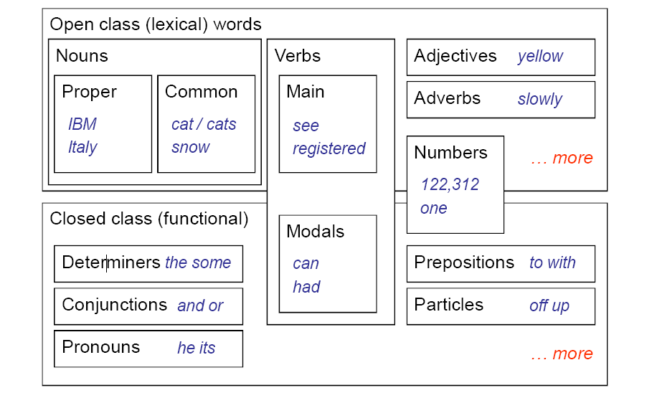
Example Task
POS tagging
Annotate each word in a sentence with a part-of-speech.
John saw the saw.
PN V D N
Useful for subsequent syntactic parsing and word sense disambiguation, etc.
Notes:
Keyword extraction
Relation extraction
Determiner: 限定詞
Modal: 情境動詞

Slide 4
Example Task
POS tagging
John saw the saw.
The problem cannot be solved without considering the sequences.
PN V D N
“saw” is more likely to be a verb V rather than a noun N
However, the second “saw” is a noun N because a noun N is more likely to follow a determiner.

Slide 5
Outline
Hidden Markov Model (HMM)
Conditional Random Field (CRF)
Towards Deep Learning
Structured Perceptron/SVM
Notes:
What is different from RNN?

Slide 6
Outline
Hidden Markov Model (HMM)
Conditional Random Field (CRF)
Towards Deep Learning
Structured Perceptron/SVM
Notes:
What is different from RNN?

Slide 7
HMM
Just the assumption of HMM
How you generate a sentence?
Step 1
Generate a POS sequence
Based on the grammar
Step 2
Generate a sentence based on the POS sequence
Based on a dictionary
PN V D N
John saw the saw.

Slide 8
HMM – Step 1
[Slide credit: Raymond J. Mooney]
This is the grammar in your brain.
0.05
Det
Noun
0.1
D
N
0.95
0.5
0.85
Verb
end
0.05
V
0.25
0.1
PropNoun
0.8
0.4
PN
0.5
0.1
Markov Chain
0.25
0.1
start
P( “PN V D N”) = 0.4*0.8*0.25*0.95*0.1

Slide 9
HMM – Step 2
[Slide credit: Raymond J. Mooney]
“PN V D N”
Tom
bit
the
cat
John
ate
saw
a
the
dog
Mary
played
a
the
saw
bed
Alice
the
a
apple
Jerry
hit
gave
that
pen
PropNoun
Verb
Det
Noun
0.2
0.17
0.63
0.17
John
saw
the
saw
P(“John saw the saw“ | “PN V D N”)
= 0.2*0.17*0.63*0.17

Slide 10
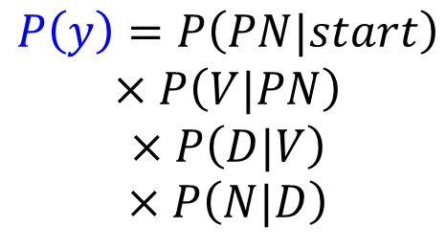
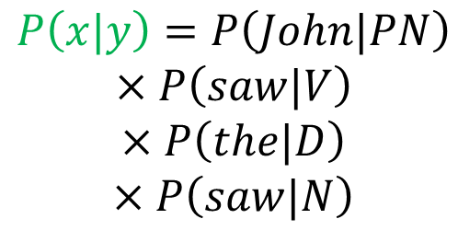
HMM
x:
John saw the saw.
y:
start
PN V D N
end
P(x,y)=P(y)P(x|y)
$$P\left(y\right)=P\left(PN|start\right)$$
$$×P\left(V|PN\right)$$
$$×P\left(D|V\right)$$
$$×P\left(N|D\right)$$
$$P\left(x|y\right)=P\left(John|PN\right)$$
$$×P\left(saw|V\right)$$
$$×P\left(the|D\right)$$
$$×P\left(saw|N\right)$$

Slide 11








HMM
x:
John saw the saw.
$$x=x_{1},x_{2}⋯x_{L}$$
y:
PN V D N
$$y=y_{1},y_{2}⋯y_{L}$$
P(x,y)=P(y)P(x|y)
Step 1
$$×\prod_{l=1}^{L−1}{P\left(y_{l+1}|y_{l}\right)}$$
$$P\left(y\right)$$
$$=P\left( y_{1}|start\right)$$
$$×P\left(end|y_{L}\right)$$
Transition probability
Step 2
$$=\prod_{l=1}^{L}{P\left(x_{l}|y_{l}\right)}$$
$$P\left(x|y\right)$$
Emission probability

Slide 12
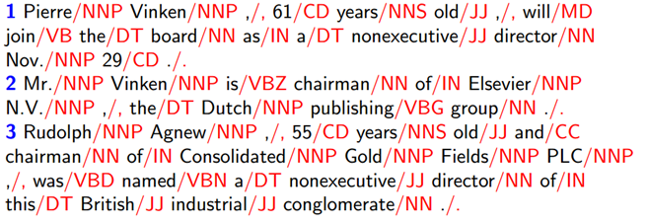



HMM – Estimating the probabilities
How can I know P(V|PN), P(saw|V) …… ?
Obtaining from training data
Training Data:
$$\left(x^{1},{\hat{y}}^{1}\right)$$
$$\left(x^{2},{\hat{y}}^{2}\right)$$
$$\left(x^{3},{\hat{y}}^{3}\right)$$
……

Slide 13
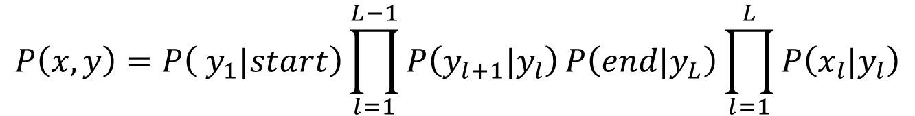
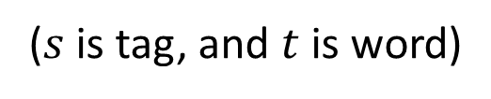
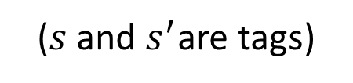
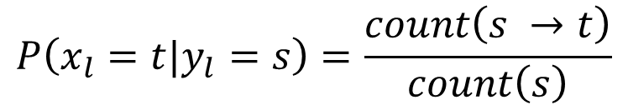
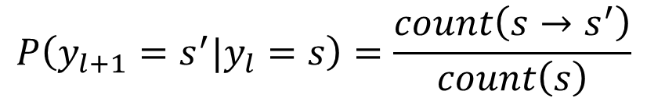
HMM – Estimating the probabilities
$$P\left(x,y\right)=P\left( y_{1}|start\right)\prod_{l=1}^{L−1}{P\left(y_{l+1}|y_{l}\right)}P\left(end|y_{L}\right)\prod_{l=1}^{L}{P\left(x_{l}|y_{l}\right)}$$
$$P\left(y_{l+1}=s^{′}|y_{l}=s\right)=\frac{count\left(s→s^{′}\right)}{count\left(s\right)}$$
($s$ and $s^{′}$are tags)
$$P\left(x_{l}=t|y_{l}=s\right)=\frac{count\left(s →t\right)}{count\left(s\right)}$$
($s$ is tag, and $t$ is word)
So simple ☺
Notes:
Why different from DSP?

Slide 14
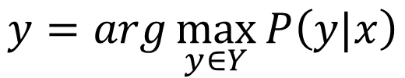
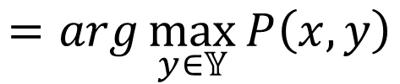
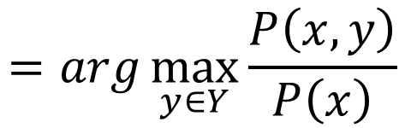
HMM – How to do POS Tagging?
We can compute P(x,y)
Observed
$$y=arg\max_{y∈Y}{P\left(y|x\right)}$$
x:
John saw the saw.
$$=arg\max_{y∈Y}{\frac{P\left(x,y\right)}{P\left(x\right)}}$$
y:
PN V D N
Hidden
Task: given x, find y
$$=arg\max_{y∈𝕐}{P\left(x,y\right)}$$

Slide 15
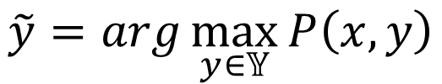
HMM – Viterbi Algorithm
Enumerate all possible y
Assume there are |S| tags, and the length of sequence y is L
There are |S|^{L} possible y
Viterbi algorithm
Solve the above problem with complexity O(L|S|²)
$$\tilde{y}=arg\max_{y∈𝕐}{P\left(x,y\right)}$$
Notes:
Test your algorithm
Greedy search
Can you really find the y maximizing P(x,y) in this way?
Slides for Viterbi
http://courses.washington.edu/ling570/gina_fall11/slides/ling570_class12_viterbi.pdf
Greedy algorithm
Not necessary find the best solution

Slide 16
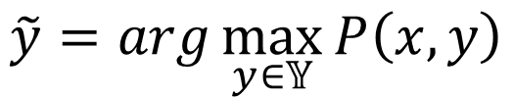
HMM - Summary
Problem 1: Evaluation
Problem 2: Inference
Problem 3: Training
F(x,y)=P(x,y)= P(y)P(x|y)
$$\tilde{y}=arg\max_{y∈𝕐}{P\left(x,y\right)}$$
P(y) and P(x|y) can be simply obtained from training data
Notes:
Different from DSP

Slide 17
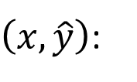


HMM - Drawbacks
Inference:
To obtain correct results …
$$\tilde{y}=arg\max_{y∈𝕐}{P\left(x,y\right)}$$
$\left(x,\hat{y}\right)$:
$$P\left(x,\hat{y}\right)>P\left(x,y\right)$$
Can HMM guarantee that?
not necessarily small
x_{l}=a
x_{l}=c
Transition probability:
1/2
1/2
……
9/10
y_{l}=V
P(V|N)=9/10
P(D|N)=1/10
Emission probability:
y_{l-1}=N
x_{l}=a
……
P(a|V)=1/2
P(a|D)=1
1
1/10
y_{l}=D

Slide 18
HMM - Drawbacks
Inference:
To obtain correct results …
$$\tilde{y}=arg\max_{y∈𝕐}{P\left(x,y\right)}$$
$\left(x,\hat{y}\right)$:
$$P\left(x,\hat{y}\right)>P\left(x,y\right)$$
Can HMM guarantee that?
not necessarily small
Transition probability:
x_{l}=a
P(V|N)=9/10
P(D|N)=1/10
……
P(x_{l}|y_{l})
Emission probability:
y_{l-1}=N
y_{l}=?
……
V
P(a|V)=1/2
P(a|D)=1
P(y_{l}|y_{l-1})

Slide 19
HMM - Drawbacks
x_{l}=a
P(x_{l}|y_{l})
y_{l-1}=N
y_{l}=?
V
D
P(y_{l}|y_{l-1})
Inference:
To obtain correct results …
$$\tilde{y}=arg\max_{y∈𝕐}{P\left(x,y\right)}$$
$\left(x,\hat{y}\right)$:
$$P\left(x,\hat{y}\right)>P\left(x,y\right)$$
Can HMM guarantee that?
not necessarily small
c
a
Transition probability:
N
V
P
V
X 9
X 9
P(V|N)=9/10
P(D|N)=1/10
……
a
a
Emission probability:
N
D
N
V
……
P(a|V)=1/2
P(a|D)=1
High probability for HMM

Slide 20
HMM - Drawbacks
The (x,y) never seen in the training data can have large probability P(x,y).
Benefit:
When there is only little training data
c
a
More complex model can deal with this problem
N
P
V
V
X 9
X 9
a
a
However, CRF can deal with this problem based on the same model
N
D
N
V
High probability for HMM
Notes:
When the labels are noisy

Slide 21
Outline
Hidden Markov Model (HMM)
Conditional Random Field (CRF)
Towards Deep Learning
Structured Perceptron/SVM
Notes:
What is different from RNN?

Slide 22
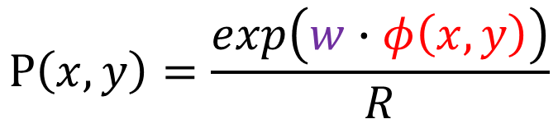

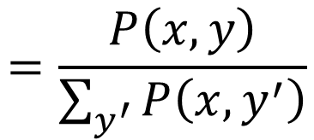

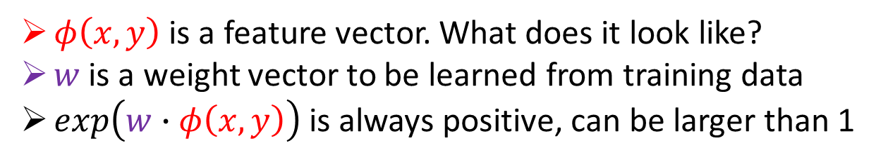
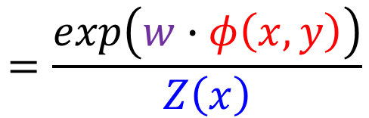
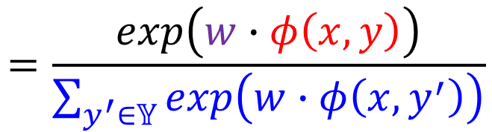
CRF
$$P\left(x,y\right)∝exp\left(w∙φ\left(x,y\right)\right)$$
$φ\left(x,y\right)$ is a feature vector. What does it look like?
$w$ is a weight vector to be learned from training data
$exp\left(w∙φ\left(x,y\right)\right)$ is always positive, can be larger than 1
$$=\frac{P\left(x,y\right)}{\sum_{y^{′}}{P\left(x,y^{′}\right)}}$$
$$P\left(x,y\right)=\frac{exp\left(w∙φ\left(x,y\right)\right)}{R}$$
$$P\left(y|x\right)$$
$$=\frac{exp\left(w∙φ\left(x,y\right)\right)}{\sum_{y^{′}∈𝕐}{exp\left(w∙φ\left(x,y^{′}\right)\right)}}$$
$$=\frac{exp\left(w∙φ\left(x,y\right)\right)}{Z\left(x\right)}$$

Slide 23
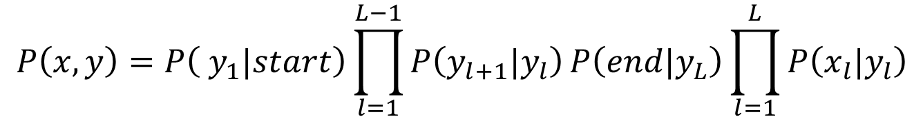


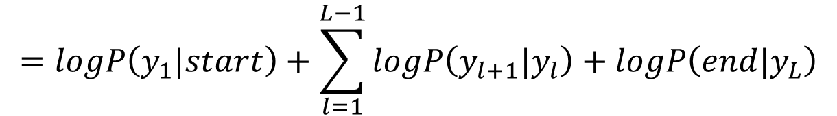
P(x,y) for CRF
$$P\left(x,y\right)∝exp\left(w∙φ\left(x,y\right)\right)$$
very different from HMM?
In HMM:
$$P\left(x,y\right)=P\left( y_{1}|start\right)\prod_{l=1}^{L−1}{P\left(y_{l+1}|y_{l}\right)}P\left(end|y_{L}\right)\prod_{l=1}^{L}{P\left(x_{l}|y_{l}\right)}$$
$$logP\left(x,y\right)$$
$$=logP\left(y_{1}|start\right)+\sum_{l=1}^{L−1}{logP\left(y_{l+1}|y_{l}\right)}+logP\left(end|y_{L}\right)$$
$$+\sum_{l=1}^{L}{logP\left(x_{l}|y_{l}\right)}$$
Notes:
意味著

Slide 24
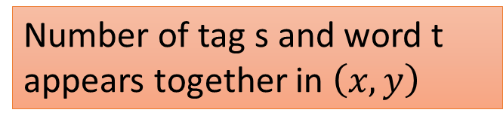
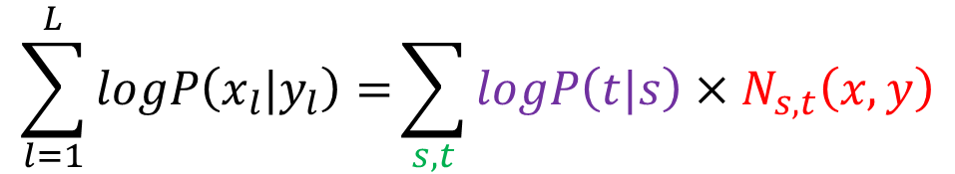


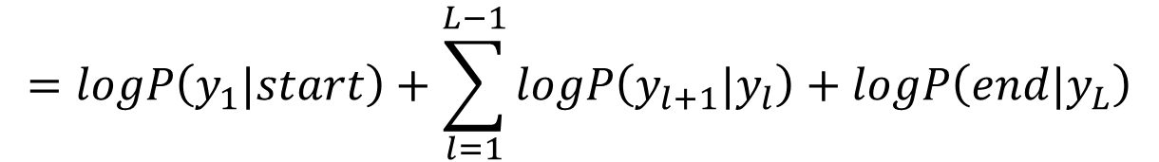
P(x,y) for CRF
$$=logP\left(y_{1}|start\right)+\sum_{l=1}^{L−1}{logP\left(y_{l+1}|y_{l}\right)}+logP\left(end|y_{L}\right)$$
$$logP\left(x,y\right)$$
$$+\sum_{l=1}^{L}{logP\left(x_{l}|y_{l}\right)}$$
Log probability of word t given tag s
Number of tag s and word t appears together in $\left(x,y\right)$
$$\sum_{l=1}^{L}{logP\left(x_{l}|y_{l}\right)=}\sum_{s,t}{logP\left(t|s\right)×N_{s,t}\left(x,y\right)}$$
Enumerate all possible tags s and all possible word t

Slide 25
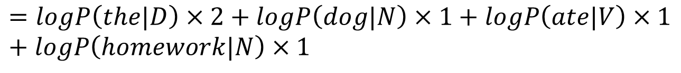
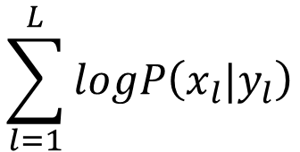

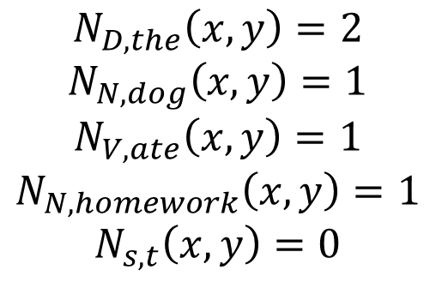
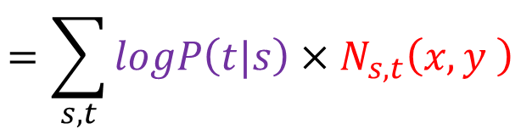
P(x,y) for CRF
$$N_{D,the}\left(x,y\right)=2$$
$$N_{N,dog}\left(x,y\right)=1$$
$$N_{V,ate}\left(x,y\right)=1$$
$$N_{N,homework}\left(x,y\right)=1$$
$$N_{s,t}\left(x,y\right)=0$$
x:
The dog ate the homework.
y:
D N V D N
$$\sum_{l=1}^{L}{logP\left(x_{l}|y_{l}\right)}$$
(for any other s and t)
$$=logP\left(the|D\right)+logP\left(dog|N\right)+logP\left(ate|V\right)+logP\left(the|D\right)+logP\left(homework|N\right)$$
$$=logP\left(the|D\right)×2+logP\left(dog|N\right)×1+logP\left(ate|V\right)×1+logP\left(homework|N\right)×1$$
$$=\sum_{s,t}{logP\left(t|s\right)×N_{s,t}\left(x,y \right)}$$

Slide 26
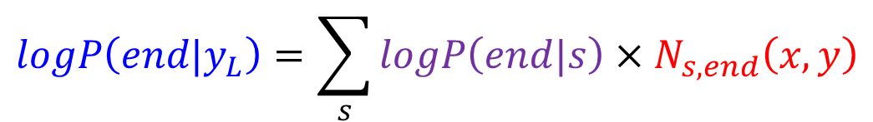
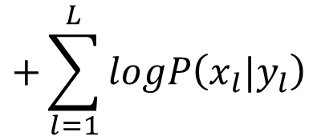
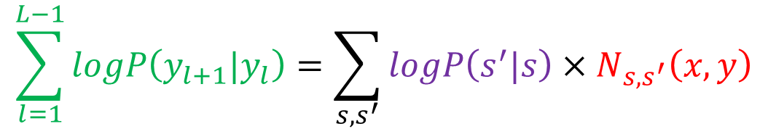
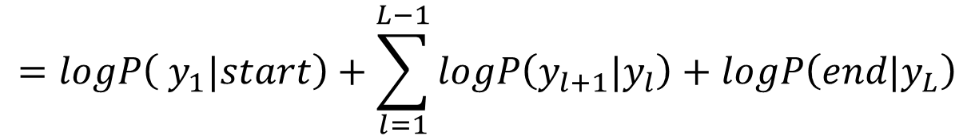
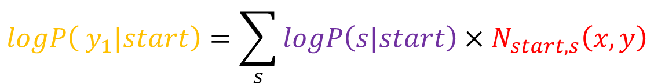

P(x,y) for CRF
$$logP\left(x,y\right)$$
$$=logP\left( y_{1}|start\right)+\sum_{l=1}^{L−1}{logP\left(y_{l+1}|y_{l}\right)}+logP\left(end|y_{L}\right)$$
$$+\sum_{l=1}^{L}{logP\left(x_{l}|y_{l}\right)}$$
$$logP\left( y_{1}|start\right)=\sum_{s}{logP\left(s|start\right)×N_{start,s}\left(x,y\right)}$$
$$\sum_{l=1}^{L−1}{logP\left(y_{l+1}|y_{l}\right)}=\sum_{s,s^{′}}{logP\left(s^{′}|s\right)×N_{s,s^{′}}\left(x,y\right)}$$
$$logP\left(end|y_{L}\right)=\sum_{s}{logP\left(end|s\right)×N_{s,end}\left(x,y\right)}$$

Slide 27
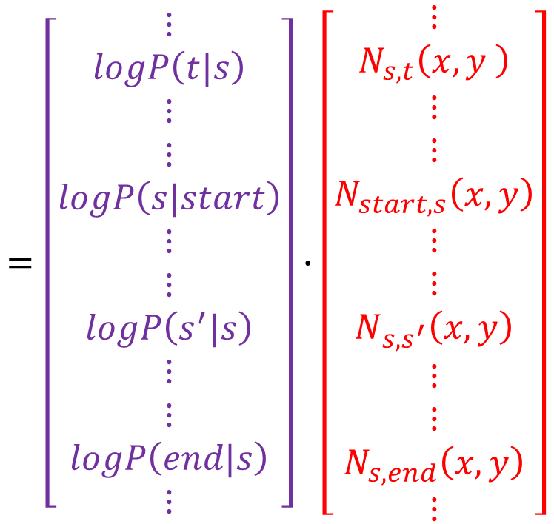
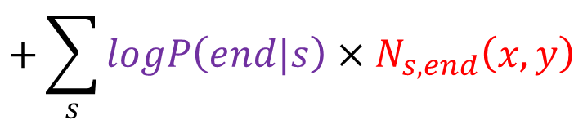
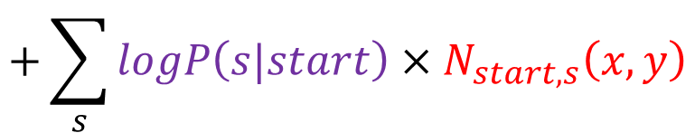
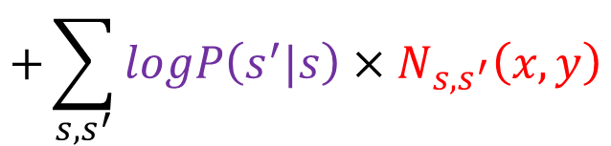




P(x,y) for CRF
$$=\left[\begin{aligned}⋮ \\ logP\left(t|s\right) \\ ⋮ \\ ⋮ \\ logP\left(s|start\right) \\ ⋮ \\ ⋮ \\ logP\left(s^{′}|s\right) \\ ⋮ \\ ⋮ \\ logP\left(end|s\right) \\ ⋮\end{aligned}\right]∙\left[\begin{aligned}⋮ \\ N_{s,t}\left(x,y \right) \\ ⋮ \\ ⋮ \\ N_{start,s}\left(x,y\right) \\ ⋮ \\ ⋮ \\ N_{s,s^{′}}\left(x,y\right) \\ ⋮ \\ ⋮ \\ N_{s,end}\left(x,y\right) \\ ⋮\end{aligned}\right]$$
$$logP\left(x,y\right)$$
$$=\sum_{s,t}{logP\left(t|s\right)×N_{s,t}\left(x,y \right)}$$
$$+\sum_{s}{logP\left(s|start\right)×N_{start,s}\left(x,y\right)}$$
$$+\sum_{s,s^{′}}{logP\left(s^{′}|s\right)×N_{s,s^{′}}\left(x,y\right)}$$
$$=w∙φ\left(x,y\right)$$
$$+\sum_{s}{logP\left(end|s\right)×N_{s,end}\left(x,y\right)}$$
$$P\left(x,y\right)=exp\left(w∙φ\left(x,y\right)\right)$$

Slide 28
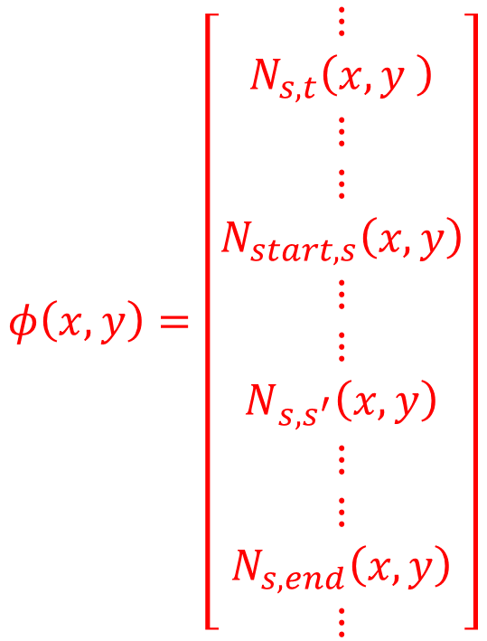






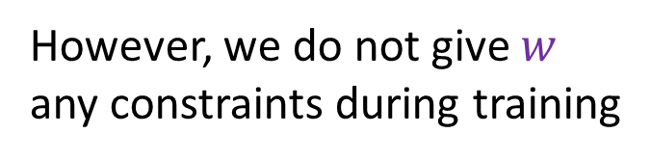



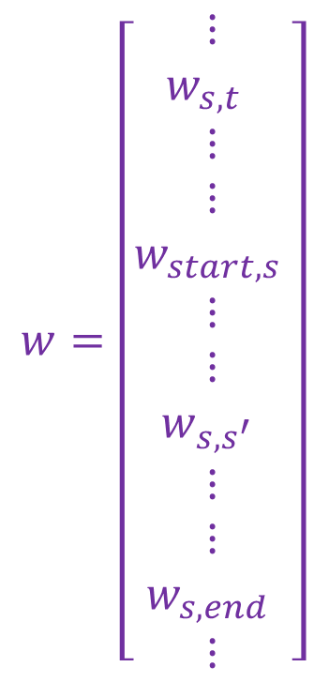

P(x,y) for CRF
$$∝$$
However, we do not give $w$ any constraints during training
$$P\left(x,y\right)=exp\left(w∙φ\left(x,y\right)\right)$$
$$φ\left(x,y\right)=\left[\begin{aligned}⋮ \\ N_{s,t}\left(x,y \right) \\ ⋮ \\ ⋮ \\ N_{start,s}\left(x,y\right) \\ ⋮ \\ ⋮ \\ N_{s,s^{′}}\left(x,y\right) \\ ⋮ \\ ⋮ \\ N_{s,end}\left(x,y\right) \\ ⋮\end{aligned}\right]$$
$$w=\left[\begin{aligned}⋮ \\ w_{s,t } \\ ⋮ \\ ⋮ \\ w_{start,s} \\ ⋮ \\ ⋮ \\ w_{s,s^{′}} \\ ⋮ \\ ⋮ \\ w_{s,end} \\ ⋮\end{aligned}\right]$$
$$logP\left(x_{i}=t|y_{i}=s\right)$$
$$P\left(x_{i}=t|y_{i}=s\right)=e^{w_{s,t }}$$
means
$$logP\left(s|start\right)$$
$$P\left(s|start\right)=e^{w_{start,s}}$$
means
$$logP\left(y_{i}=s^{′}|y_{i−1}=s\right)$$
$$P\left(y_{i}=s^{′}|y_{i−1}=s\right)=e^{w_{s,s^{′}}}$$
means
$$logP\left(end|s\right)$$
$$……$$
Notes:
Not sum to one, but who cares?

Slide 29
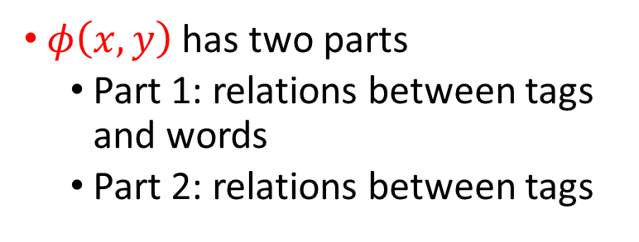
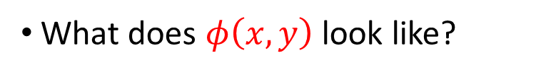
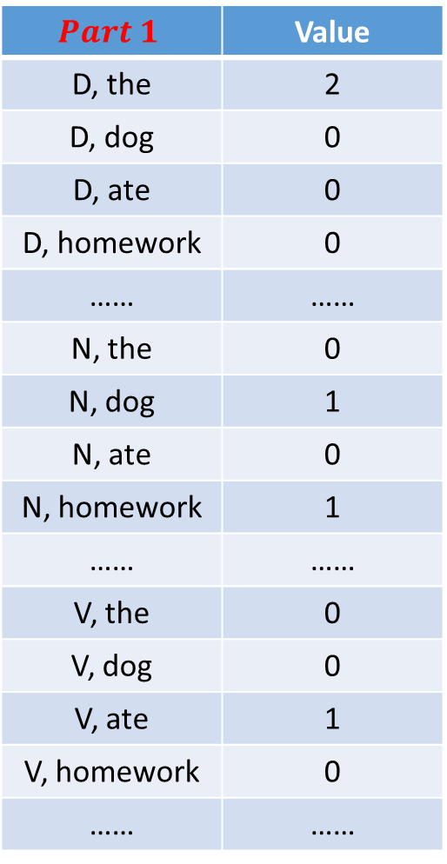
Feature Vector
$$Part 1$$ | Value
D, the | 2
D, dog | 0
D, ate | 0
D, homework | 0
…… | ……
N, the | 0
N, dog | 1
N, ate | 0
N, homework | 1
…… | ……
V, the | 0
V, dog | 0
V, ate | 1
V, homework | 0
…… | ……
What does $φ\left(x,y\right)$ look like?
x:
The dog ate the homework.
y:
D N V D N
$φ\left(x,y\right)$ has two parts
Part 1: relations between tags and words
Part 2: relations between tags
If there are |S| possible tags, |L| possible words
Part 1 has |S| X |L| dimensions

Slide 30

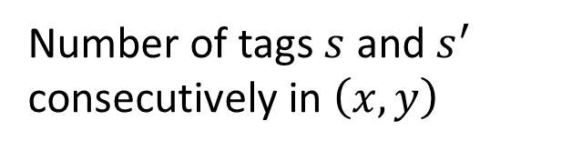
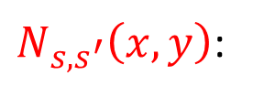


Feature Vector
$$Part 2$$ | Value
D, D | 0
D, N | 2
D, V | 0
…… | ……
N, D | 0
N, N | 0
N, V | 1
…… | ……
V, D | 1
V, N | 0
V, V | 0
…… | ……
Start, D | 1
Start, N | 0
…… | ……
End, D | 0
End, N | 1
$$N_{D,D}\left(x,y\right)→$$
$$N_{D,N}\left(x,y\right)→$$
What does $φ\left(x,y\right)$ look like?
x:
The dog ate the homework.
y:
D N V D N
$φ\left(x,y\right)$ has two parts
Part 1: relations between tags and words
Part 2: relations between tags
$N_{s,s^{′}}\left(x,y\right)$:
Number of tags $s$ and $s^{′}$ consecutively in $\left(x,y\right)$

Slide 31

Feature Vector
$$Part 2$$ | Value
D, D | 0
D, N | 2
D, V | 0
…… | ……
N, D | 0
N, N | 0
N, V | 1
…… | ……
V, D | 1
V, N | 0
V, V | 0
…… | ……
Start, D | 1
Start, N | 0
…… | ……
End, D | 0
End, N | 1
What does $φ\left(x,y\right)$ look like?
x:
The dog ate the homework.
y:
D N V D N
$φ\left(x,y\right)$ has two parts
Part 1: relations between tags and words
Part 2: relations between tags
If there are |S| possible tags,
|S| X |S| + 2 |S| dimensions
Define any $φ\left(x,y\right)$ you like!

Slide 32






CRF – Training Criterion
$$P\left(y|x\right)$$
$$=\frac{P\left(x,y\right)}{\sum_{y^{′}}{P\left(x,y^{′}\right)}}$$
Given training data: $\left\{\left(x^{1},{\hat{y}}^{1}\right),\left(x^{2},{\hat{y}}^{2}\right),⋯\left(x^{N},{\hat{y}}^{N}\right)\right\}$
Find the weight vector $w^{∗}$ maximizing objective function $O\left(w\right)$:
$$O\left(w\right)=\sum_{n=1}^{N}{logP\left({\hat{y}}^{n}|x^{n}\right)}$$
$$w^{∗}=arg\max_{w}{O\left(w\right)}$$
$$logP\left({\hat{y}}^{n}|x^{n}\right)=logP\left(x^{n},{\hat{y}}^{n}\right)−log\sum_{y^{′}}{P\left(x^{n},y^{′} \right)}$$
Maximize what we observe
Minimize what we don’t observe
Notes:
Gradient Ascent …
What is the best weight vector $w^{∗}$?
Different from count
Cross entropy?????
You can sum, another way

Slide 33




CRF – Gradient Ascent
Gradient descent
Find a set of parameters $θ$ minimizing cost function $C\left(θ\right)$
Opposite direction of the gradient
$$θ→θ−η∇C\left(θ\right)$$
Gradient Ascent
Find a set of parameters $θ$ maximizing objective function O$\left(θ\right)$
The same direction of the gradient
$$θ→θ+η∇O\left(θ\right)$$

Slide 34




CRF - Training
$$O\left(w\right)=\sum_{n=1}^{N}{logP\left({\hat{y}}^{n}|x^{n}\right)}=\sum_{n=1}^{N}{O^{n}\left(w\right)}$$
$$∇O^{n}\left(w\right)=\left[\begin{aligned}⋮ \\ {∂O^{n}\left(w\right)}/{∂w_{s,t}} \\ ⋮ \\ {∂O^{n}\left(w\right)}/{∂w_{s,s^{′}}} \\ ⋮\end{aligned}\right]$$
Let me show $\frac{∂O^{n}\left(w\right)}{∂w_{s,t}}$
Compute
$\frac{∂O^{n}\left(w\right)}{∂w_{s,s^{′}}}$ very similar

Slide 35







CRF - Training
$$P\left(y^{′}|x^{n}\right)=\frac{exp\left(w∙φ\left(x^{n},y^{′}\right)\right)}{Z\left(x^{n}\right)}$$
$$w_{s,t}→w_{s,t}+η\frac{∂O\left(w\right)}{∂w_{s,t}}$$
After some math ……
Can be computed by Viterbi algorithm as well
$$\frac{∂O^{n}\left(w\right)}{∂w_{s,t}}$$
$$−\sum_{y^{′}}{P\left(y^{′}|x^{n}\right)}N_{s,t }\left(x^{n},y^{′}\right)$$
$$=N_{s,t}\left(x^{n},{\hat{y}}^{n}\right)$$
If word t is labeled by tag s in training examples $\left(x^{n},{\hat{y}}^{n}\right)$, then increase $w_{s,t}$
If word t is labeled by tag s in $\left(x^{n},y^{′}\right)$ which not in training examples, then decrease $w_{s,t}$
Notes:
Some intuition here
$$w→w+η∇O\left(w\right)$$
$$\frac{∂O\left(w\right)}{∂w_{s,t}}=\sum_{r=1}^{R}{\frac{∂O^{r}\left(w\right)}{∂w_{s,t}}}$$

Slide 36



CRF - Training
$$P\left(y^{′}|x^{n}\right)=\frac{exp\left(w∙φ\left(x^{n},y^{′}\right)\right)}{Z\left(x^{n}\right)}$$
$$∇O\left(w\right)=φ\left(x^{n},{\hat{y}}^{n}\right)−\sum_{y^{′}}{P\left(y^{′}|x^{n}\right)}φ\left(x^{n},y^{′}\right)$$
Stochastic Gradient Ascent
Random pick a data $\left(x^{n},{\hat{y}}^{n}\right)$
$$w→w+η\left(φ\left(x^{n},{\hat{y}}^{n}\right)−\sum_{y^{′}}{P\left(y^{′}|x^{n}\right)}φ\left(x^{n},y^{′}\right) \right)$$

Slide 37




CRF – Inference
Inference
$$y=arg\max_{y∈Y}{P\left(y|x\right)}$$
$$=arg\max_{y∈Y}{P\left(x,y\right)}$$
$$=arg\max_{y∈Y}{w∙φ\left(x,y\right)}$$
Done by Viterbi as well
$$P\left(x,y\right)∝exp\left(w∙φ\left(x,y\right)\right)$$
Notes:
Use HMM -> transform it back to probablity

Slide 38



CRF v.s. HMM
CRF: increase $P\left(x,\hat{y}\right)$, decrease $P\left(x,y^{′}\right)$
To obtain correct results …
HMM does not do that
CRF more likely to achieve that than HMM
$\left(x,\hat{y}\right)$:
$$P\left(x,\hat{y}\right)>P\left(x,y\right)$$
c
a
HMM:
CRF:
x_{i}=a
P(V|N)=9/10
N
V
P
V
P(x_{i}|y_{i})
X 9
X 9
P(D|N)=1/10
a
y_{i-1}=N
y_{i}=?
P(a|V)=1/2
0.1
P(y_{i}|y_{i-1})
HMM:V
N
D
P(a|D)=1
CRF:D

Slide 39

Synthetic Data
$x_{i}∈\left\{a−z\right\}$, $y_{i}∈\left\{A−E\right\}$
Generating data from a mixed-order HMM
Transition probability:
$αP\left(y_{i}|y_{i−1} \right)+\left(1−α\right)P\left(y_{i}|y_{i−1},y_{i−2}\right)$
Emission probability:
$αP\left(x_{i}|y_{i} \right)+\left(1−α\right)P\left(x_{i}|y_{i},x_{i−1}\right)$
Comparing HMM and CRF
All the approaches only consider 1-st order information
Only considering the relation of $y_{i−1}$ and $y_{i}$
In general, all the approaches have worse performance with smaller $α$
Ref: John D. Lafferty, Andrew McCallum, and Fernando C. N. Pereira, “Conditional Random Fields: Probabilistic Models for Segmenting and Labeling Sequence Data”, ICML, 2001
Notes:
1000

Slide 40




Synthetic Data: CRF v.s. HMM
Data are generated from HMM
1-st order HMM assumption is inaccurate
$$α<\frac{1}{2}$$
CRF
HMM>CRF
$$α>\frac{1}{2}$$
CRF>HMM
Smaller $α$
HMM

Slide 41






CRF - Summary
Problem 1: Evaluation
Problem 2: Inference
Problem 3: Training
$$=\frac{exp\left(w∙φ\left(x,y\right)\right)}{\sum_{y^{′}∈𝕐}{exp\left(w∙φ\left(x,y^{′}\right)\right)}}$$
$$F\left(x,y\right)=P\left(y|x\right)$$
$$\tilde{y}=arg\max_{y∈𝕐}{P\left(y|x\right)}$$
$$=arg\max_{y∈𝕐}{w∙φ\left(x,y\right)}$$
$$w^{∗}=arg\max_{w}{\prod_{n=1}^{N}{P\left({\hat{y}}^{n}|x^{n}\right)}}$$
$$w→w+η\left(φ\left(x^{n},{\hat{y}}^{n}\right)−\sum_{y^{′}}{P\left(y^{′}|x^{n}\right)}φ\left(x^{n},y^{′}\right) \right)$$

Slide 42
Outline
Hidden Markov Model (HMM)
Conditional Random Field (CRF)
Towards Deep Learning
Structured Perceptron/SVM
Notes:
What is different from RNN?

Slide 43






Structured Perceptron
Problem 1: Evaluation
Problem 2: Inference
Problem 3: Training
The same as CRF
$$F\left(x,y\right)=w∙φ\left(x,y\right)$$
$$\tilde{y}=arg\max_{y∈𝕐}{\text{w}\text{∙}φ\text{(}\text{x}\text{,}\text{y}\text{)}}$$
Viterbi
$$∀n,∀y∈𝕐,y≠{\hat{y}}^{n}:$$
$$w∙φ\left(x^{n},{\hat{y}}^{n}\right)>w∙φ\left(x^{n},y\right)$$
$${\tilde{y}}^{n}=arg\max_{y}{w∙φ\left(x^{n},y\right)}$$
$$w→w+φ\left(x^{n},{\hat{y}}^{n}\right)−φ\left(x^{n},{\tilde{y}}^{n}\right)$$

Slide 44



Structured Perceptron v.s. CRF
Structured Perceptron
CRF
$${\tilde{y}}^{n}=arg\max_{y}{w∙φ\left(x^{n},y\right)}$$
$$w→w+φ\left(x^{n},{\hat{y}}^{n}\right)−φ\left(x^{n},{\tilde{y}}^{n}\right)$$
Hard
$$w→w+η\left(φ\left(x^{n},{\hat{y}}^{n}\right)−\sum_{y^{′}}{P\left(y^{′}|x^{n}\right)}φ\left(x^{n},y^{′}\right) \right)$$
Soft

Slide 45


Structured SVM
Problem 1: Evaluation
Problem 2: Inference
Problem 3: Training
$$F\left(x,y\right)=w∙φ\left(x,y\right)$$
The same as CRF
$$\tilde{y}=arg\max_{y∈𝕐}{\text{w}\text{∙}φ\text{(}\text{x}\text{,}\text{y}\text{)}}$$
Viterbi
Consider margin and error:
Way 1. Gradient Descent
Way 2. Quadratic Programming (Cutting Plane Algorithm)

Slide 46




Structured SVM – Error Function
Error function: $∆\left({\hat{y}}^{n},y\right)$
$∆\left({\hat{y}}^{n},y\right)$: Difference between $y$ and ${\hat{y}}^{n}$
Cost function of structured SVM is the upper bound of $∆\left({\hat{y}}^{n},y\right)$
Theoretically, $∆\left(y,{\hat{y}}^{n}\right)$ can be any function you like
However, you need to solve Problem 2.1
${\overline{y}}^{n}=arg\max_{y}\left[∆\left({\hat{y}}^{n},y\right)+w∙φ\left(x^{n},y\right)\right]$
Example
$\hat{y}$:
A T T C G G G G A T
$∆\left(\hat{y},y\right)=$3/10
$y$:
A T T A G G A G A A
In this case, problem 2.1 can be solved by Viterbi Algorithm
Notes:
Edit distance -> you can’t solve it
inimize the error computing on the training set
If $y$ and $y^{′}$ are sequences:

Slide 47


POS Tagging
Performance of Different Approaches
Ref: Nguyen, Nam, and Yunsong Guo. "Comparisons of sequence labeling algorithms and extensions." ICML, 2007.
Name Entity Recognition
Ref: Tsochantaridis, Ioannis, et al. "Large margin methods for structured and interdependent output variables." Journal of Machine Learning Research. 2005.
Notes:
(There is still no guarantees that Structured SVM is better than CRF.)

Slide 48
Outline
Hidden Markov Model (HMM)
Conditional Random Field (CRF)
Towards Deep Learning
Structured Perceptron/SVM
Notes:
What is different from RNN?

Slide 49


How about RNN?
RNN, LSTM
Unidirectional RNN does not consider the whole sequence
Cost and error not always related
Deep
HMM, CRF, Structured Perceptron/SVM
Using Viterbi, so consider the whole sequence
How about Bidirectional RNN?
Can explicitly consider the label dependency
Cost is the upper bound of error
?

Slide 50

Integrated together
HMM, CRF, Structured Perceptron/SVM
Explicitly model the dependency
Deep
Cost is the upper bound of error
RNN, LSTM
http://photo30.bababian.com/upload1/20100415/42E9331A6580A46A5F89E98638B8FD76.jpg

Slide 51



Integrated together
Speech Recognition: CNN/RNN or LSTM/DNN + HMM
$$P\left(x,y\right)=P\left( y_{1}|start\right)\prod_{l=1}^{L−1}{P\left(y_{l+1}|y_{l}\right)}P\left(end|y_{L}\right)\prod_{l=1}^{L}{P\left(x_{l}|y_{l}\right)}$$
P(a|x_{l})
P(b|x_{l})
P(c|x_{l})
……
$$P\left(x_{l}|y_{l}\right)=\frac{P\left(x_{l},y_{l}\right)}{P\left(y_{l}\right)}$$
……
RNN
……
……
RNN
$$=\frac{P\left(y_{l}|x_{l}\right)P\left(x_{l}\right)}{P\left(y_{l}\right)}$$
……
x_{l}
……
Count

Slide 52


Integrated together
Semantic Tagging: Bi-directional RNN/LSTM + CRF/Structured SVM
……
……
$$w∙φ\left(x,y\right)$$
……
……
RNN
……
……
Testing:
RNN
$$\tilde{y}=arg\max_{y∈𝕐}{\text{w}\text{∙}φ\text{(}\text{x}\text{,}\text{y}\text{)}}$$
……
……
Notes:
Training
Mesnil, G., Dauphin, Y., Kaisheng Yao, Bengio, Y., Li Deng, Hakkani-Tur, D., Xiaodong He, Heck, L., Tur, G., Dong Yu, Zweig, G., "Using Recurrent Neural Networks for Slot Filling in Spoken Language Understanding," in Audio, Speech, and Language Processing, IEEE/ACM Transactions on , vol.23, no.3, pp.530-539, March 2015

Slide 53

Concluding Remarks
 | Problem 1 | Problem 2 | Problem 3
HMM | $$F\left(x,y\right)=P\left(x,y\right)$$ | Viterbi | Just count
CRF | $F\left(x,y\right)=P\left(y|x\right)$ | Viterbi | Maximize $P\left(\hat{y}|x\right)$
Structured Perceptron | $F\left(x,y\right)=w∙φ\left(x,y\right)$ (not a probability) | Viterbi | $$F\left(x,\hat{y}\right)>F\left(x,y^{′}\right)$$
Structured SVM | $F\left(x,y\right)=w∙φ\left(x,y\right)$ (not a probability) | Viterbi | $F\left(x,\hat{y}\right)>F\left(x,y^{′}\right)$ with margins
The above approaches can combine with deep learning to have better performance.
Notes:
CTC: http://citeseerx.ist.psu.edu/viewdoc/summary?doi=10.1.1.75.6306
Connectionist temporal classification: Labelling unsegmented sequence data with recurrent neural networks (2006)

Slide 54
Acknowledgement
感謝 曹爗文 同學於上課時發現投影片上的錯誤
感謝 Ryan Sun 來信指出投影片上的錯誤

Slide 55
Appendix
Notes:
Why not just use RNN?
add constraint?
How about bidirectional->Upper Bound ?
To add:
Markov model -> Hidden Markov Model
Viterbi
Viterbi + Error

Slide 56










CRF - Training
$$O^{n}\left(w\right)=log\frac{exp\left(w∙φ\left(x^{n},{\hat{y}}^{n}\right)\right)}{Z\left(x^{n}\right)}$$
$$Z\left(x^{n}\right)=\sum_{y^{′}}{exp\left(w∙φ\left(x^{n},y^{′}\right)\right)}$$
$$=w∙φ\left(x^{n},{\hat{y}}^{n}\right)−logZ\left(x^{n}\right)$$
$$\frac{∂O^{n}\left(w\right)}{∂w_{s,t}}$$
$$=N_{s,t}\left(x^{n},{\hat{y}}^{n}\right)$$
$$w∙φ\left(x^{n},{\hat{y}}^{n}\right)$$
The number of word t labeled as s in$\left(x^{n},{\hat{y}}^{n}\right)$
$$=\sum_{s,t}{w_{s,t}∙N_{s,t}\left(x^{n},{\hat{y}}^{n}\right)}$$
The value of the dimension in $φ\left(x^{n},{\hat{y}}^{n}\right)$ corresponding to $w_{s,t}$.
$$+\sum_{s,s^{′}}{w_{s,s^{′}}∙N_{s,s^{′}}\left(x^{n},{\hat{y}}^{n}\right)}$$
Notes:
Some intuition here

Slide 57




CRF - Training
$$O^{n}\left(w\right)=log\frac{exp\left(w∙φ\left(x^{n},{\hat{y}}^{n}\right)\right)}{Z\left(x^{n}\right)}$$
$$Z\left(x^{n}\right)=\sum_{y^{′}}{exp\left(w∙φ\left(x^{n},y^{′}\right)\right)}$$
$$=w∙φ\left(x^{n},{\hat{y}}^{n}\right)−logZ\left(x^{n}\right)$$
$$\frac{∂O^{n}\left(w\right)}{∂w_{s,t}}$$
$$−\frac{1}{Z\left(x^{n}\right)}\frac{∂Z\left(x^{n}\right)}{∂w_{s,t}}$$
$$=N_{s,t}\left(x^{n},{\hat{y}}^{n}\right)$$
$$=\sum_{y^{′}}{\frac{exp\left(w∙φ\left(x^{n},y^{′}\right)\right)}{Z\left(x^{n}\right)}}N_{s,t}\left(x^{n},y^{′}\right)$$
$$=\sum_{y^{′}}{P\left(y^{′}|x^{n}\right)}N_{s,t }\left(x^{n},y^{′}\right)$$
$$\frac{∂Z\left(x^{n}\right)}{∂w_{s,t}}=\sum_{y^{′}}{exp\left(w∙φ\left(x^{n},y^{′}\right)\right)}N_{s,t}\left(x^{n},y^{′}\right)$$
Notes:
Some intuition here

Slide 58

CRF v.s. HMM
Define $φ\left(x,y\right)$ you like
For example, besides the features just described, there are some useful extra features in POS tagging.
Number of times a capitalized word is labeled as Noun
Number of times a word end with ing is labeled as Noun
Can you consider this kind of features by HMM?
Too sparse…
$$P\left(x_{i}=A,x_{i} is capitalized,x_{i} end with \text{ing},…|y_{i}=N\right)$$
Method 1:
$P\left(x_{i}=A|y_{i}=N\right)P\left(x_{i} is capitalized|y_{i}=N\right)$……
Inaccurate assumption
Method 2. Give the distribution some assumptions?
Notes:
whether I should memtion HMM independen assumption here
But some feature may make inference difficult

